Slide 1
Stock Analysis App
Team 6:
Hannah Nguyen
Puskar Dev
Safi Ullah

Slide 2
Stock Analysis App
Employing AI for real-time stock market analysis
With the rise of online brokerage like Robinhood, Webull many people are into buying/selling/shorting stocks.
It will provide you info on how your stock is doing in the market

Slide 3
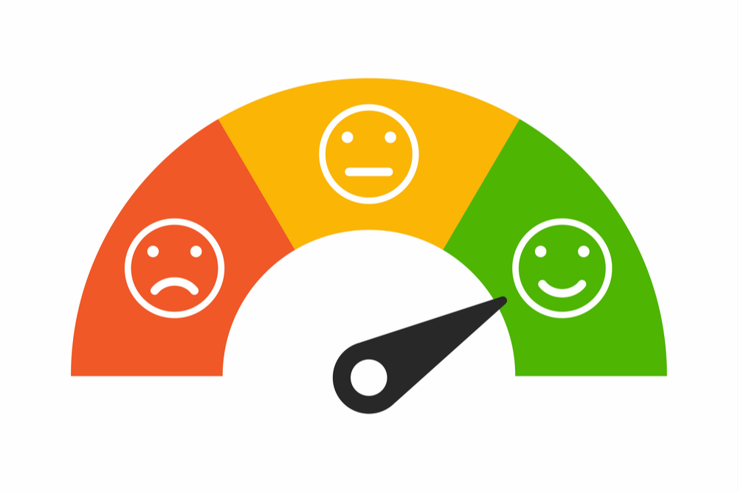
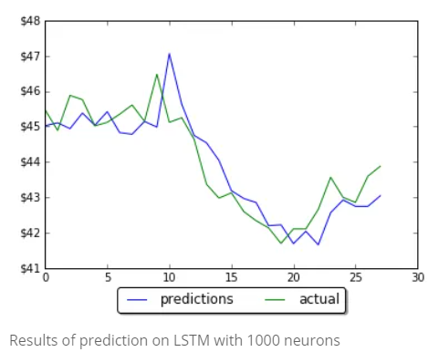
How it works?
For a given stock, results will delivered based from two factors:
Sentiment Analysis on news/posts/headlines
Price predicting model using time-series forecast
Recommendation will also be provided if you should keep/sell/invest in a particular stock.
Notes:
https://www.translatemedia.com/us/blog-usa/machine-translation-multilingual-sentiment-analysis-projects/
http://intelligentonlinetools.com/blog/2018/01/19/machine-learning-stock-prediction-lstm-keras/

Slide 4
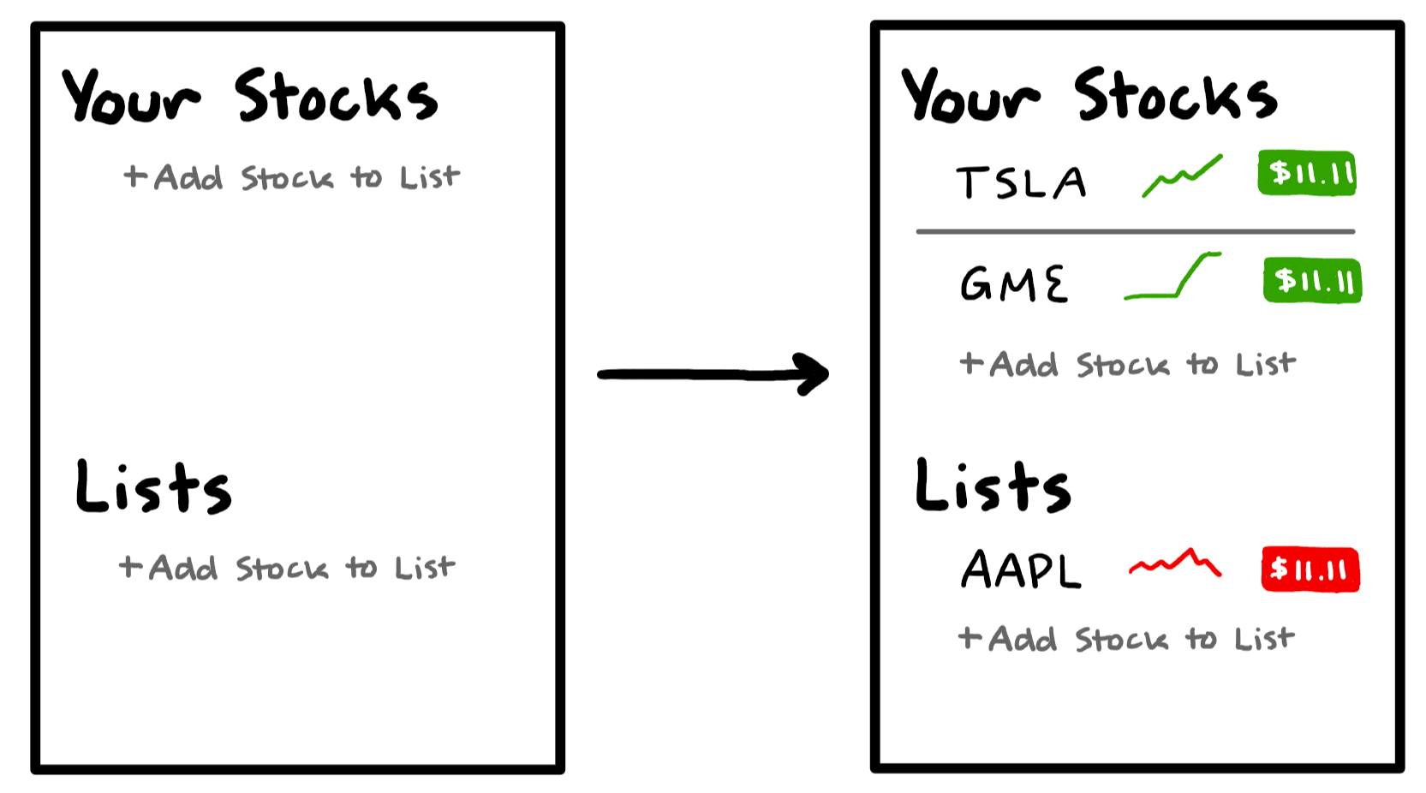
Homepage

Slide 5
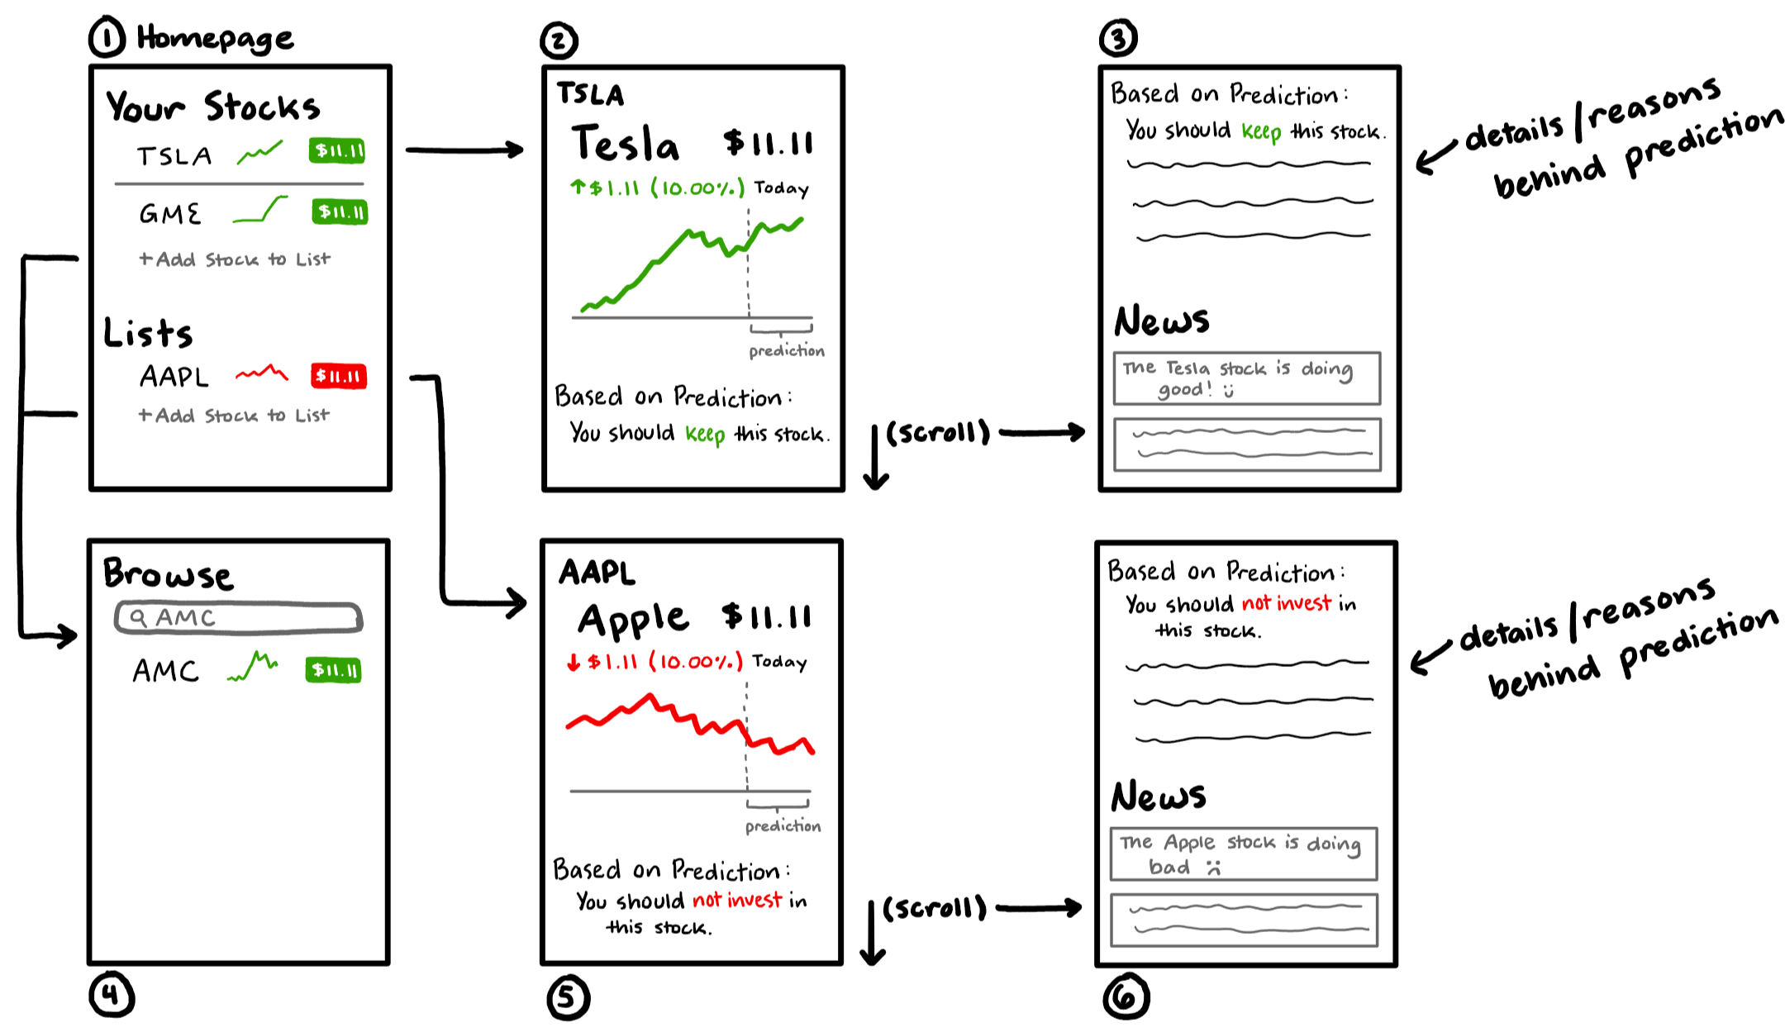

Slide 6
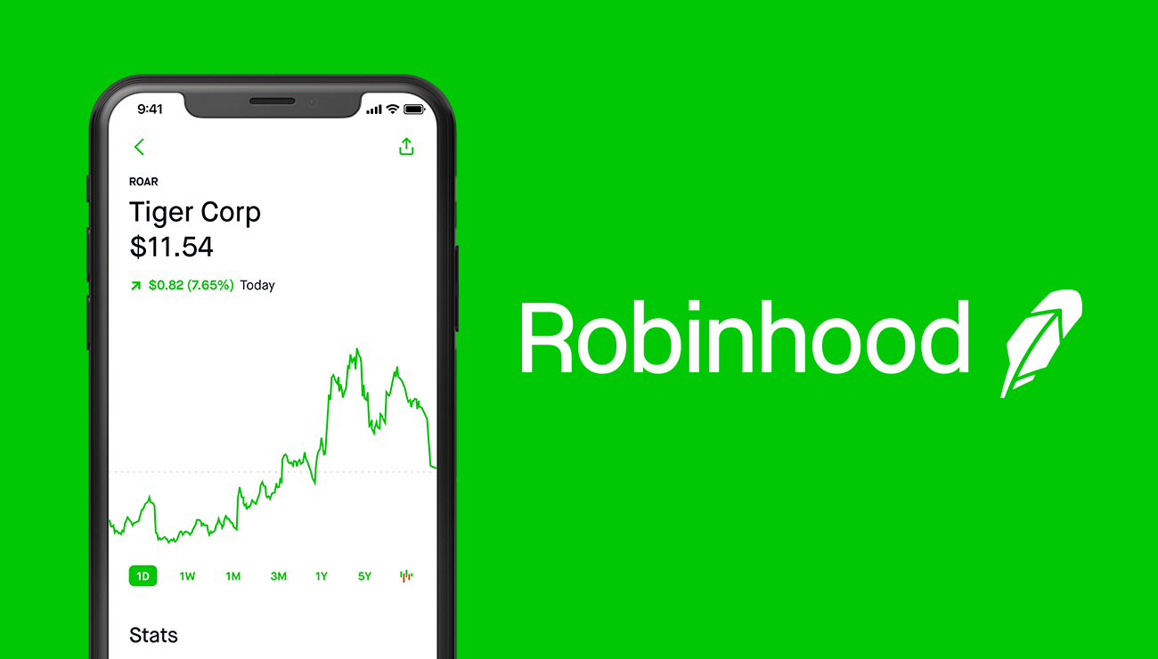
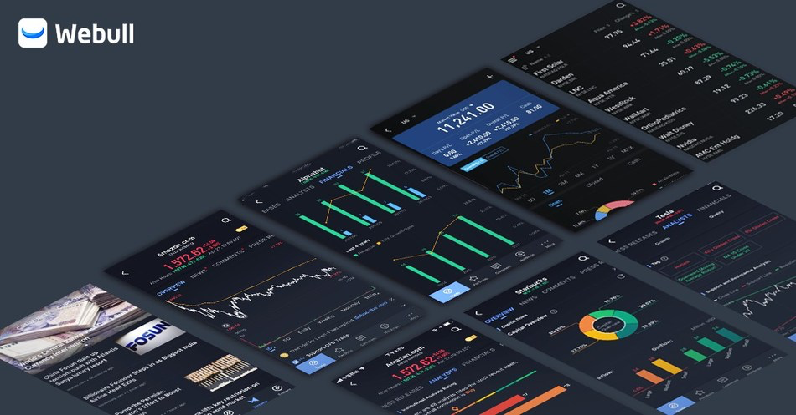
WHY USE A STOCK APP?

Slide 7

WHAT MAKES US DIFFERENT?

Slide 8
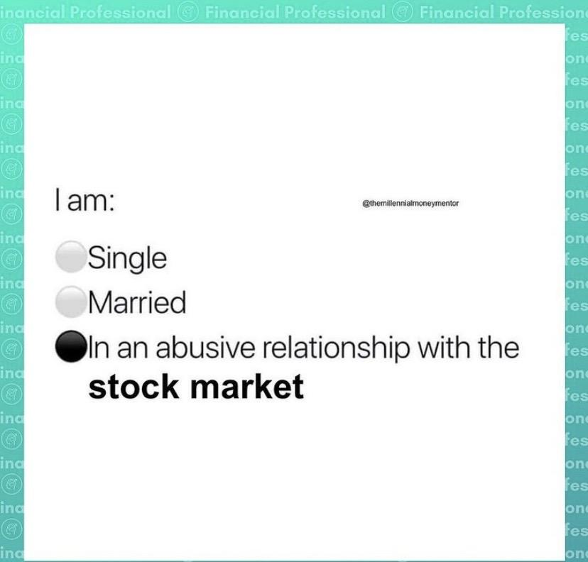
CONCLUSION
Notes:
@financialprofessional

Slide 9
Github Link: https://github.com/puskardev/StockApp

Slide 10
THANK YOU
QUESTIONS?

